Slide 1


What is a Feature?
Noida Institute of Engineering and Technology, Greater Noida
A feature is a significant piece of information extracted from a data/image which provides more detailed understanding of the data/image.

Slide 2
A Picture Is Worth More Than A Thousand Words
Noida Institute of Engineering and Technology, Greater Noida
Image analysis (understanding),
image processing & computer vision plays an important role in society today because
🞭 A picture gives a much clearer impression of a situation or an
object.
🞭 Having an accurate visual perspective of things has a high social, technical and economic value.

Slide 3



Noida Institute of Engineering and Technology, Greater Noida
The machine learning framework
Apply a prediction function to a feature representation of the image to get the desired output:
f( ) = “apple”
f( ) = “tomato”
f( ) = “cow”

Slide 4
The machine learning framework
Noida Institute of Engineering and Technology, Greater Noida
y = f(x)
output
prediction function
Image feature
Training: given a training set of labeled examples
{(x₁,y₁), …, (x_{N},y_{N})}, estimate the prediction function f by
minimizing the prediction error on the training set
Testing: apply f to a never before seen test example x and output the predicted value y = f(x)

Slide 5
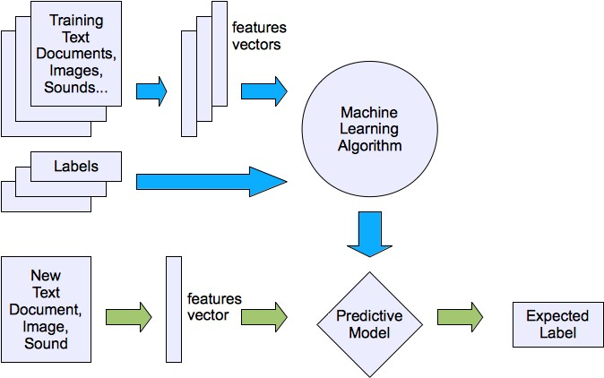
Machine learning structure
Noida Institute of Engineering and Technology, Greater Noida
System Framework

Slide 6
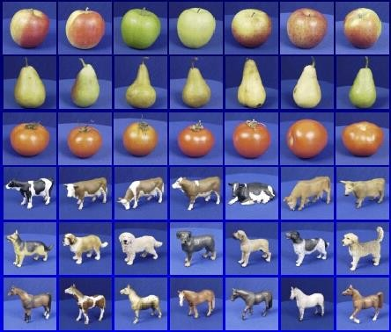

Steps
Noida Institute of Engineering and Technology, Greater Noida
Training
Training Images
Training Labels
Image Features
Training
Learned model
Testing
Image
Features
Learned
model
Prediction
Test Image

Slide 7
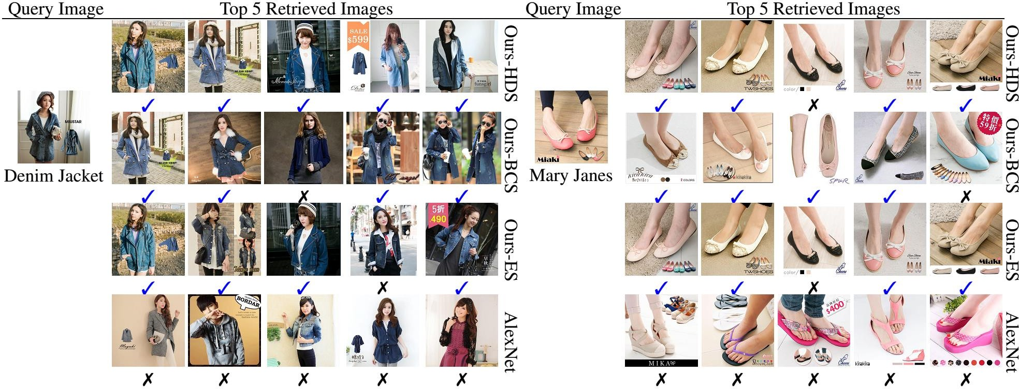
Image Retrieval
Noida Institute of Engineering and Technology, Greater Noida

Slide 8
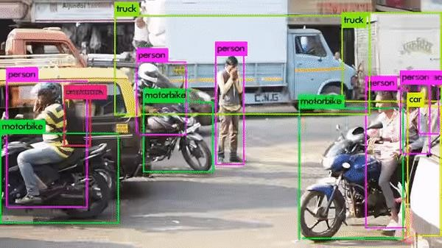
Object Detection & Classification
Noida Institute of Engineering and Technology, Greater Noida

Slide 9
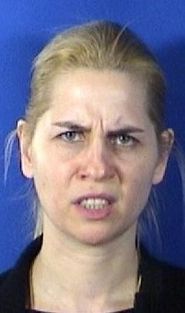
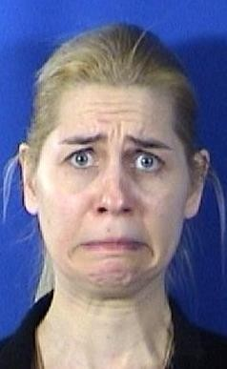

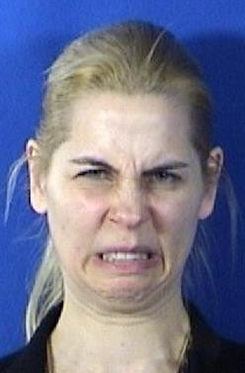
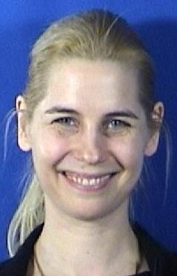
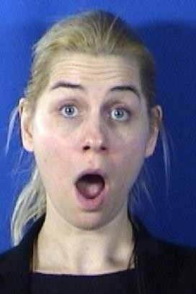
Macro v/s Micro Expressions
Noida Institute of Engineering and Technology, Greater Noida
Disgust
Happy
Surprise
Anger
Fear
Sad
MMI Dataset
Macro Expression

Slide 10
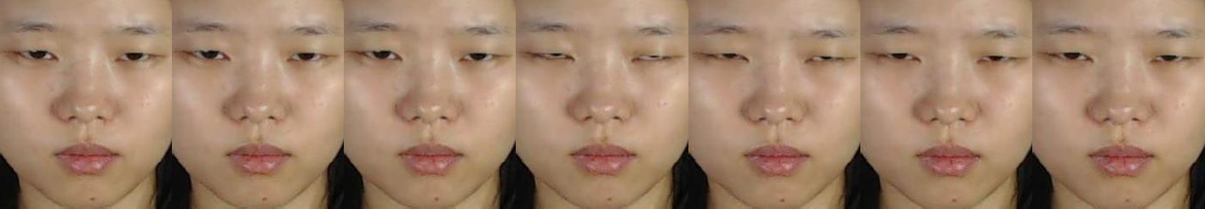
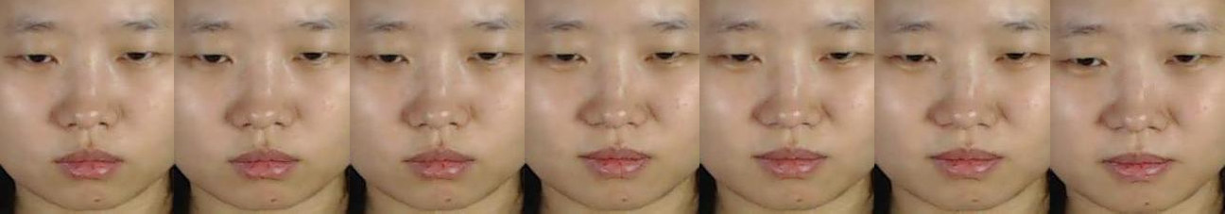
Noida Institute of Engineering and Technology, Greater Noida
Sample Micro Expression
Disgust Expression
Happy expression

Slide 11
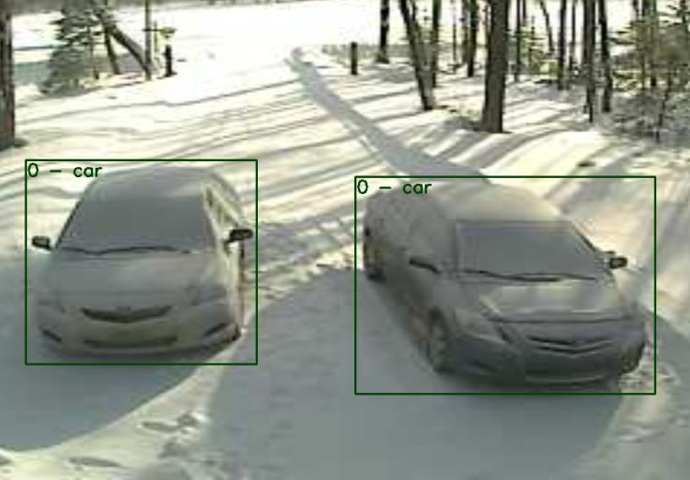
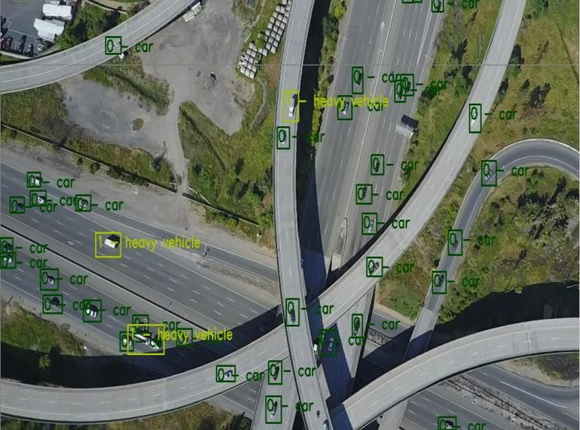
Regular Vs Aerial View
Noida Institute of Engineering and Technology, Greater Noida
Regular View Aerial View
Difference between regular and aerial view

Slide 12
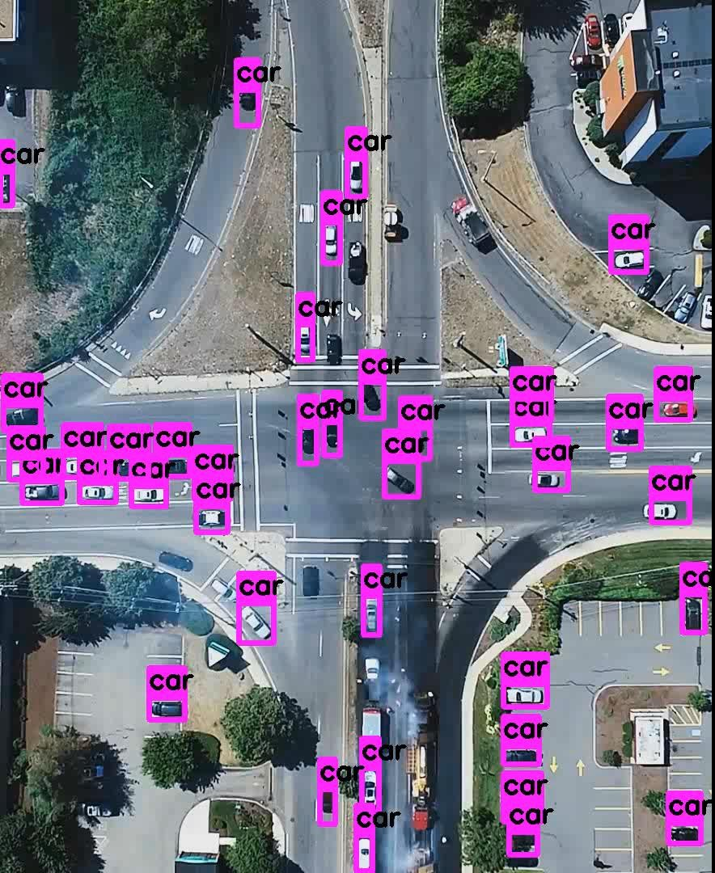
Sample Results
Noida Institute of Engineering and Technology, Greater Noida

Slide 13
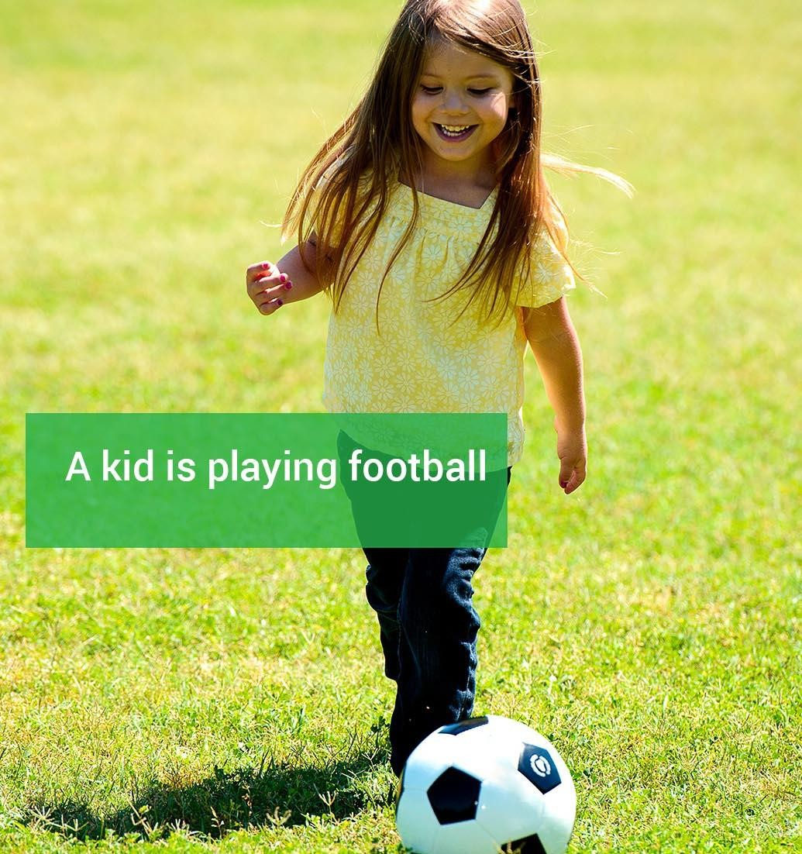
Image Captioning
Noida Institute of Engineering and Technology, Greater Noida
Automatically describing the content of an image and generate a reasonable description in plain English. NIC(Neural Image Caption) is model which take image in input and generate description.

Slide 14
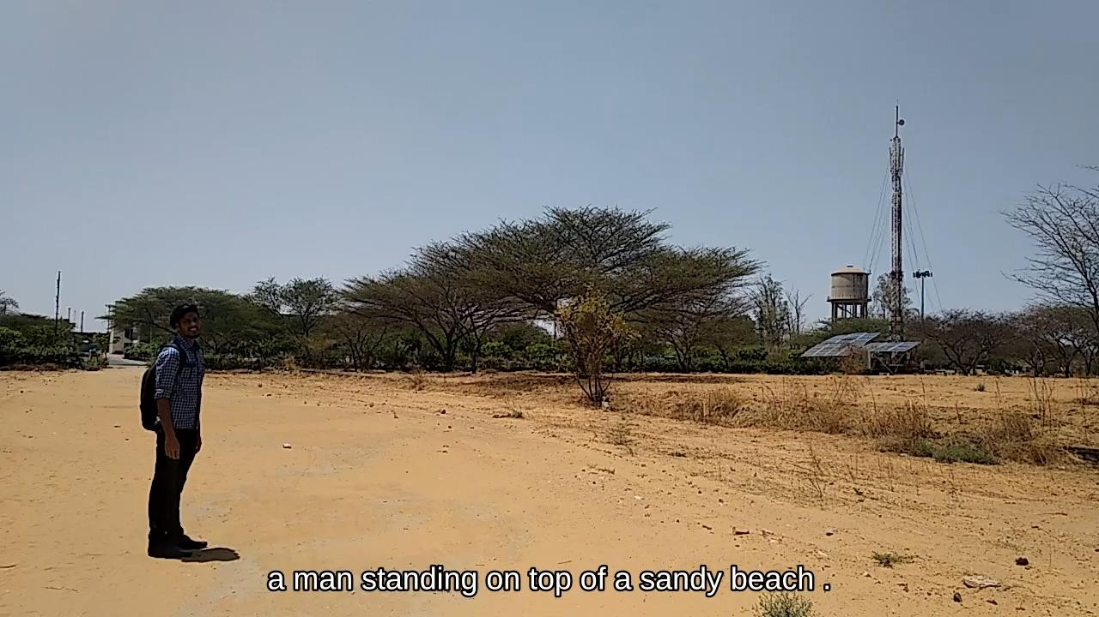
Noida Institute of Engineering and Technology, Greater Noida

Slide 15

Generalization
Noida Institute of Engineering and Technology, Greater Noida
Training set (labels known)
Test set (labels
unknown)
How well does a learned model generalize from the data it was trained on to a new test set?

Slide 16

Local Binary & Ternary Patterns (LBP & LTP)
Pattern
Noida Institute of Engineering and Technology, Greater Noida
9 | 7 | 5 | 2 | 1
3 | 17 | 9 | 1 | 4 |  | 1 | 1 | 0
6 | 8 | 9 | 14 | 5 |  | 1 |  | 1
2 | 2 | 10 | 7 | 6 |  | 0 | 1 | 0
1 | 9 | 8 | 9 | 10
 |  |  |  |  |  | 1 | 0 | 0
 |  |  |  |  |  | 0 |  | 1
LBP
8 | 4 | 2
16 |  | 1
32 | 64 | 128
 | 93
LTP
8 | 4 | 2
16 |  | 1
32 | 64 | 128
 | 9
0
0
0
1 | 0 | -1
0 |  | 1
-1 | 0 | 0
0 | 0 | 1
0 |  | 0
1 | 0 | 0
8 | 4 | 2
16 |  | 1
32 | 64 | 128
 | 34
τ = 2[7,11]
Fig: Example of obtaining LBP and LTP for the 3 × 3 pattern

Slide 17
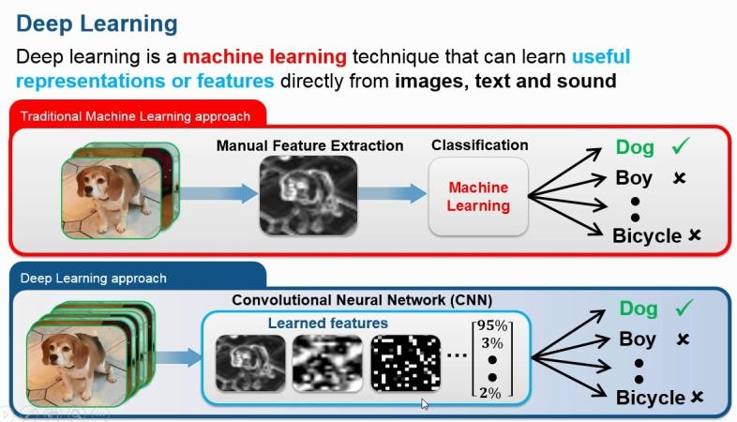
Noida Institute of Engineering and Technology, Greater Noida

Slide 18
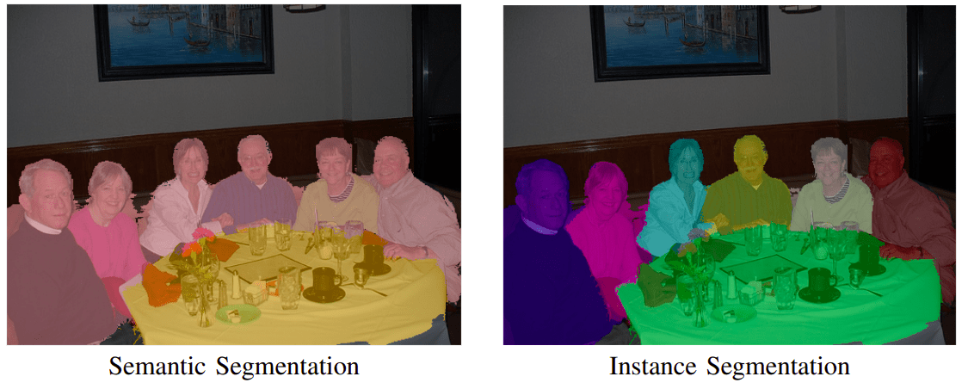
Noida Institute of Engineering and Technology, Greater Noida
What is image segmentation?
As the term suggests this is the process of dividing an image into multiple segments. In this process, every pixel in the image is associated with an object type. There are two major types of image segmentation — semantic segmentation and instance segmentation.
In semantic segmentation, all objects of the same type are marked using one class label while in instance segmentation similar objects get their own separate labels.

Slide 19
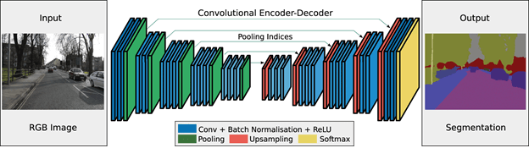
Noida Institute of Engineering and Technology, Greater Noida
Image segmentation architectures
The basic architecture in image segmentation consists of an encoder and a decoder.

Slide 20
Noida Institute of Engineering and Technology, Greater Noida
The encoder extracts features from the image through filters. The decoder is responsible for generating the final output which is usually a segmentation mask containing the outline of the object. Most of the architectures have this architecture or a variant of it.
U-Net
U-Net is a convolutional neural network originally developed for segmenting biomedical images. When visualized its architecture looks like the letter U and hence the name U-Net.
Its architecture is made up of two parts, the left part – the contracting path and the right part – the expansive path. The purpose of the contracting path is to capture context while the role of the expansive path is to aid in precise localization.

Slide 21
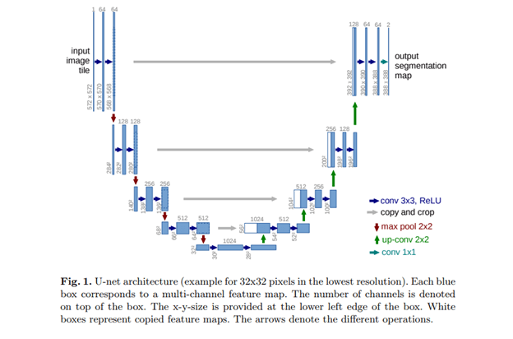
Noida Institute of Engineering and Technology, Greater Noida

Slide 22
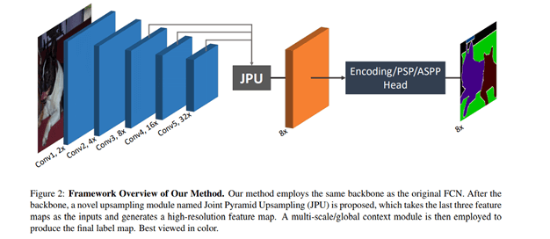
Noida Institute of Engineering and Technology, Greater Noida
The contracting path is made up of two three-by-three convolutions. The convolutions are followed by a rectified linear unit and a two-by-two max-pooling computation for downsampling.
U-Net’s full implementation can be found here.
FastFCN —Fast Fully Convolutional Network
In this architecture, a Joint Pyramid Upsampling(JPU) module is used to replace dilated convolutions since they consume a lot of memory and time. It uses a fully-connected network at its core while applying JPU for upsampling. JPU upsamples the low-resolution feature maps to high-resolution feature maps.

Slide 23
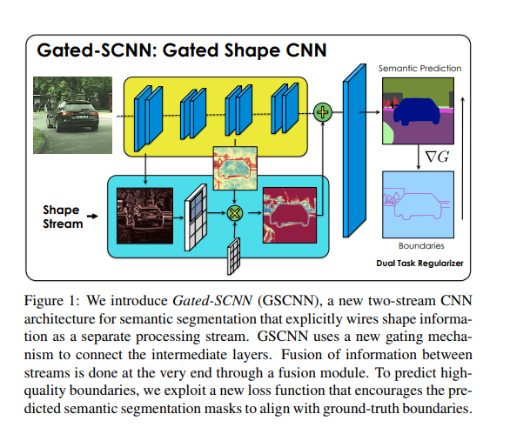
Noida Institute of Engineering and Technology, Greater Noida
Gated-SCNN
This architecture consists of a two-stream CNN architecture. In this model, a separate branch is used to process image shape information. The shape stream is used to process boundary information.

Slide 24
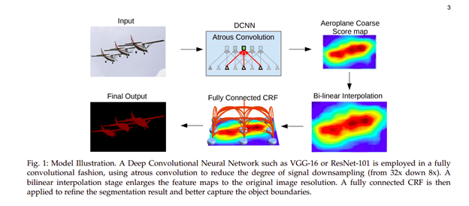
Noida Institute of Engineering and Technology, Greater Noida
DeepLab
In this architecture, convolutions with upsampled filters are used for tasks that involve dense prediction. Segmentation of objects at multiple scales is done via atrous spatial pyramid pooling. Finally, DCNNs are used to improve the localization of object boundaries. Atrous convolution is achieved by upsampling the filters through the insertion of zeros or sparse sampling of input feature maps.

Slide 25
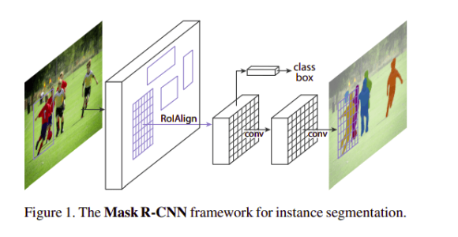
Noida Institute of Engineering and Technology, Greater Noida
Mask R-CNN
In this architecture, objects are classified and localized using a bounding box and semantic segmentation that classifies each pixel into a set of categories. Every region of interest gets a segmentation mask. A class label and a bounding box are produced as the final output. The architecture is an extension of the Faster R-CNN. The Faster R-CNN is made up of a deep convolutional network that proposes the regions and a detector that utilizes the regions.

Slide 26
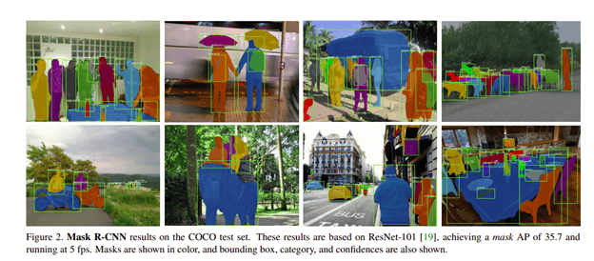
Noida Institute of Engineering and Technology, Greater Noida
Now, let’s work on a couple of Mask R-CNN use cases to automatically segment and construct pixel-wise masks for each object in an image.

Slide 27
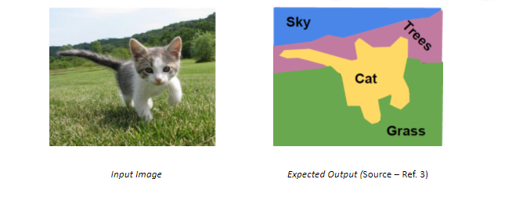
Noida Institute of Engineering and Technology, Greater Noida
Semantic Segmentation
Also known as dense prediction, the goal of a semantic segmentation task is to label each pixel of the input image with the respective class representing a specific object/body. Segmentation is performed when the spatial information of a subject and how it interacts with it is important, like for an Autonomous vehicle.
Also, one key thing to note is that this task is not interested in distinguishing multiple objects belonging to a certain class. For example, if you have two cars of different make and colour, they would still be given a common label of ‘Car’ and considered a single entity.

Slide 28
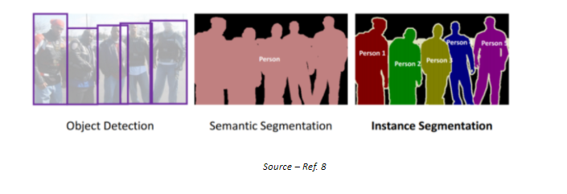
Noida Institute of Engineering and Technology, Greater Noida
Instance Segmentation
Object Instance Segmentation takes semantic segmentation one step ahead in a sense that it aims towards distinguishing multiple objects from a single class. It can be considered as a Hybrid of Object Detection and Semantic Segmentation tasks.

Slide 29
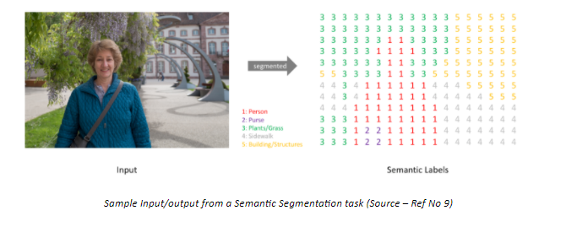
Noida Institute of Engineering and Technology, Greater Noida
Various Applications of Semantic Segmentation
Autonomous vehicles
Medical image diagnostics
Industrial Inspection
Traffic Management, etc.
Simply put, given an input image of m x n x 3 shape (RGB), the model should be able to generate a m x n matrix filled with class labels as integers at the respective location.

Slide 30
Noida Institute of Engineering and Technology, Greater Noida
Various Applications of Semantic Segmentation
Autonomous vehicles
Medical image diagnostics
Industrial Inspection
Traffic Management, etc.
Simply put, given an input image of m x n x 3 shape (RGB), the model should be able to generate a m x n matrix filled with class labels as integers at the respective location.

Slide 31
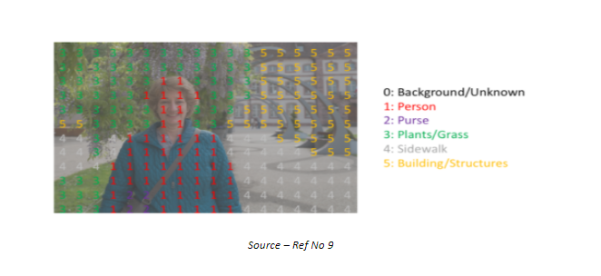
Noida Institute of Engineering and Technology, Greater Noida
Various Applications of Semantic Segmentation
Autonomous vehicles
Medical image diagnostics
Industrial Inspection
Traffic Management, etc.
Simply put, given an input image of m x n x 3 shape (RGB), the model should be able to generate a m x n matrix filled with class labels as integers at the respective location.

Slide 32
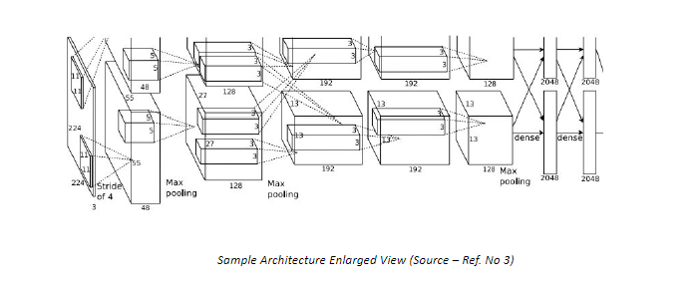
Noida Institute of Engineering and Technology, Greater Noida
Although at a first glance this Architecture seems to be good enough for carrying out the Semantic Segmentation; however it has some major drawbacks –
This approach involves prediction at individual pixel level, thus requiring a dense layer with enormous number of parameters that needs to be learned making it highly computationally expensive
In addition, the use of dense layers as final output layers leads to a constraint on the dimension of the input image. A different architecture has to be defined for different input sizes
No reusing of shared features takes place between overlapping patches, thus highly inefficient.

Slide 33
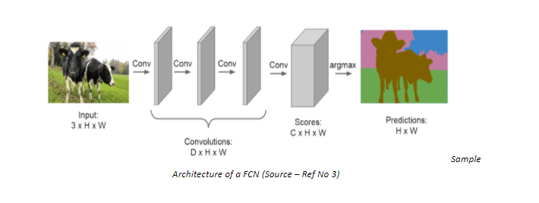
Fully Convolutional Network
One way to counter the drawbacks of the previous Architecture is by stacking a number of Convolution Layers having similar padding to preserve dimension and output a final segmentation map. Meaning the model will learn the mapping from the input image to its corresponding segmentation map through the successive transformation of feature mappings.

Slide 34
Fully Convolutional Network
Seems good, but there is a major issue with this Architecture as well. We use the same padding in all the Convolution layers because we would want the output image to be of the same dimension as the input image. But this preservation of full-resolution becomes quite computationally expensive.
We could opt for a lesser number of layers, but that would damage the performance by a large margin.
We do not face this dilemma in a classification task because for that task we are only concerned about the presence of a single object of interest, losing the information about the location of the said object is harmless. Therefore, we can periodically downsample the images through pooling. However, this is not the case with Semantic Segmentation. If you want to segment a Highway image for training an autonomous vehicle, you would not want certain elements or vehicles to be cropped out from the final output that is fed to the machine.

Slide 35
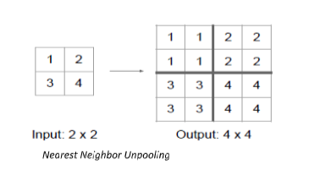
Fully Convolutional Network
Unpooling – In network upsampling
After reducing the resolution by extracting convoluted features and pooling , for the case of Semantic Segmentation the next step is to upscale the low resolution back to the original resolution of the input image. Pooling converts a patch of values to a single value, whereas unpooling does the opposite, converts a single value into a patch of values.
Like Pooling, Unpooling can be carried out in different ways –
Nearest Neighbor
In Nearest neighbor approach, we pick a value and populate the surrounding cells with that value (no. of cells depending upon the increase in resolution), see value 1 being copied to every cell of the Top-Left 2×2 square.

Slide 36
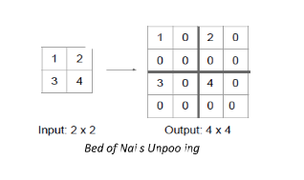
Fully Convolutional Network
2. Bed of Nails
In this approach, instead of filling all the neighboring cells with a value, we fill the value at a predefined cell and fill the rest with 0, in the above example we fill the value in the top left cell of each 2×2 square.

Slide 37
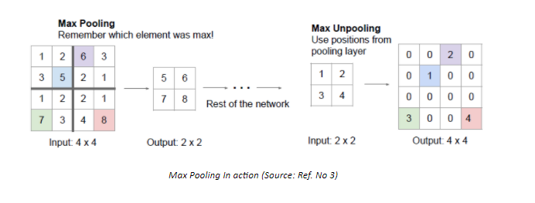
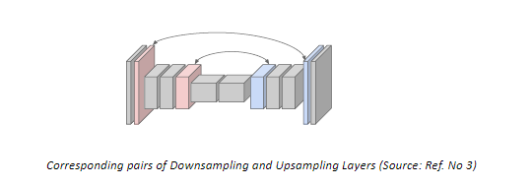
Fully Convolutional Network
3. Max Unpooling
Max pooling is an improvement over “Bed of Nails” pooling, it utilises the symmetry present in a typical Downsampling-Upsampling Network, i.e for each Downsampling layer there exists a similar Upsampling layer as well. Rather than filling the value in a predefined cell, the value is filled in the cell having maximum value in the corresponding Downsampling layer.

Slide 38
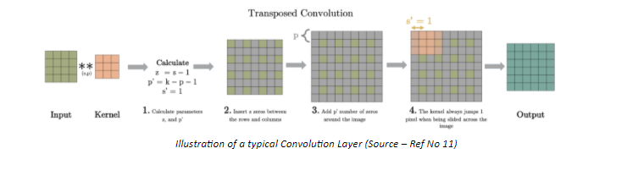
Fully Convolutional Network
Transposed Convolution
Transposed Convolution or like some people incorrectly call it Deconvolution, can be seen as an opposite action to Convolution. Unlike convolution, a transposed convolution layer is used to upsample the reduced resolution feature back to its original resolution. A set of stride and padding values is learned to obtain the final output from the lower resolution features. The below illustration explains the procedure in a very easy to understand manner.
What makes transpose convolution better than other Upsampling techniques is that unlike previously described techniques (Nearest Neighbour, Bed of Nails, Max Unpooling), transpose convolution is a learnable upsampling making it highly efficient.

Slide 39
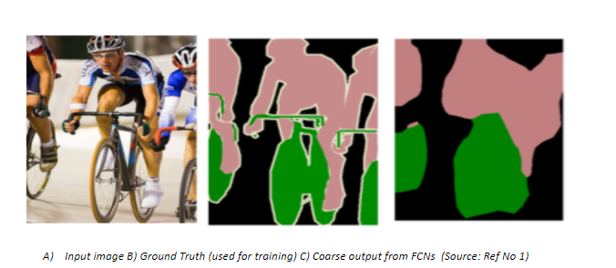
Fully Convolutional Network
Skip Connections
One major issue with in-network Downsampling in a FCN is that it reduces the resolution of the input by a large factor, thus during upsampling it becomes very difficult to reproduce the finer details even after using sophisticated techniques like Transpose Convolution. As a result we obtain a coarse output

Slide 40
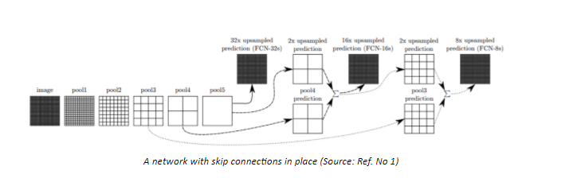
Fully Convolutional Network
Skip Connections
One-way to deal with this is by adding ‘skip connections’ in the Upsampling stage from earlier layers and summing the two feature maps. These skip connections provide enough information to later layers to generate accurate segmentation boundaries. This combination of fine and coarse layers leads to local predictions with nearly accurate global (spatial) structure.
The above illustrated network learns to combine coarse layer information with fine layer information. Layers are represented as grids with relative spatial coarseness, while the intermediate convolution layers of FCN are omitted for ease in understanding.

Slide 41
Fully Convolutional Network
FCN-32s : Upsamples at stride 32, predictions back to pixels in a single step (Basic layer without any skip connections)
FCN-16s : Combines predictions from both the final layer and the pool4 layer with stride 16, finer details than FCN-32s.
FCN-8s : Adds predictions from pool3 at stride 8, providing even further precise boundaries.
Adding Skip connections can be considered as a Boosting method for a FCN, which tries to improve performance of layers by using predictions (feature maps) from previous layers.

Slide 42
Geometric Operations
Geometric operations applied to images are typically used to transform an image and align it with another image for reconstruction or comparison, to line up features for stitching or to simply create an effect such as morphing.
A set of image transformations where the geometry of image is changed without altering its actual pixel values are commonly referred to as “Geometric” transformation. In general, you can apply multiple operations on it, but, the actual pixel values will remain unchanged.
For example, some person is clicking pictures of the same place at different times of the day and year to visualize the changes. Every time he clicks the picture, it’s not necessary that he clicks the picture at the exact same angle. So for better visualization, he can align all the images at the same angle using geometric transformation. Geometric transformation is a funfamental technique used in image processing that involves manipulating the spatial arrangement of pixels in an image.
It is used to modify the geometric properties of an image, such as its size, shape, position, and orientation. The following are some of the basic concepts of geometric transformation in image processing:

Slide 43
Geometric Operations
Transformation Functions: Transformation functions are mathematical functions used to modify the geometric properties of an image. These functions map the coordinates of each pixel in an image to new coordinates based on a specified transformation rule. Some of the commonly used transformation functions include scaling, rotation, translation, and shearing.
Coordinate System: A coordinate system is a reference system used to define the spatial location of pixels in an image. In digital image processing, the most commonly used coordinate system is the Cartesian coordinate system, which uses two perpendicular axes (x and y) to represent the horizontal and vertical positions of pixels in an image.
Interpolation: Interpolation is the process of estimating the pixel values of an image at locations that are not explicitly defined. This is necessary when transforming an image since the new coordinates may not coincide with the original pixel positions. Interpolation algorithms are used to estimate the pixel values at the new locations based on the surrounding pixel values.

Slide 44
Geometric Operations
Applications of Geometric Transformation
Geometric transformation is a versatile technique that finds a wide range of applications in image processing. Some of the common applications of geometric transformation are as follows:
Image Registration: Image registration is the process of aligning two or more images to enable comparison or analysis. Geometric transformation is used to align the images by modifying their position, orientation, or scale.
Image Rectification: Image rectification is the process of removing distortions from an image caused by the projection of a three-dimensional scene onto a two-dimensional image plane. Geometric transformation is used to correct the perspective distortion by transforming the image into a new coordinate system.
Image Resizing: Image resizing is the process of changing the size of an image while preserving its aspect ratio. Geometric transformation is used to scale the image by a factor in the x and y directions.
Image Rotation: Image rotation is the process of rotating an image by a specified angle. Geometric transformation is used to perform the rotation by mapping the original pixel positions to new positions based on the rotation angle.

Slide 45
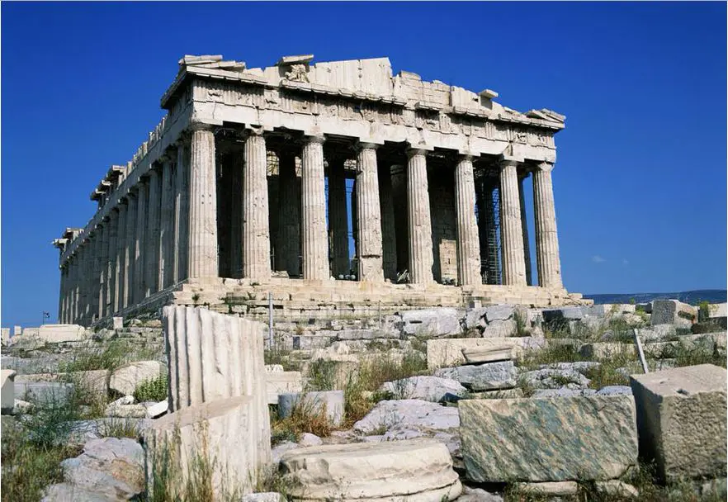

Geometric Operations
Fig.1 The Acropolis
Fig. 2 The Acropolis (from a different angle)
Here are the two different images of the same place from different angles. Now you can apply the geometric transformations as per requirement.
Different Types of Geometric Transformation
Projective Transformation
Also known as homography, this geometric transformation is the most general form and includes all other transformations mentioned above. Projective transformations can change the perspective of an image, making it suitable for tasks like panorama stitching and rectifying images.

Slide 46
Geometric Operations
Euclidean Transformation
Also known as rigid transformation, it combines translation and rotation operations. Euclidean transformation in digital image processing preserves the distances and angles between points in the image.
Perspective Transformation
Perspective transformation, also known as homography, is a projective transformation that maps points in one plane to another while preserving straight lines. It can account for changes in perspective and orientation, making it suitable for applications like image stitching, rectifying images, and augmented reality. In computer vision, perspective transformation is often represented as a 3×3 matrix called the homography matrix. When applied to an image, this matrix can correct perspective distortions, align images from different viewpoints, and create panoramas.
Matrix Multiplication and Transformations
Matrix multiplication is a fundamental operation in linear algebra that allows the combination of multiple linear transformations into a single transformation matrix. In geometric transformation, transformation matrices are used to represent various operations like rotation, scaling, translation, shearing, and perspective transformation.
By multiplying transformation matrices, multiple transformations can be combined and applied simultaneously to an image or a set of points. This enables efficient and compact representation of complex geometric transformations.

Slide 47
Geometric Operations
Affine Transformations
An affine transformation is a transformation that preserves collinearity and the ratio of distances (for example – the midpoint of a line segment is still the midpoint even after the transformation))
The parallel lines in an original image will be parallel in the output image.
In general, an affine transformation is a composition of translations, rotations, shears, and magnifications.
Now let’s discuss each one of them and learn how and where to use them.
Reflection
This geometric transformation involves flipping an image along a specified axis (horizontal, vertical, or diagonal), creating a mirror image.
Translation
Translation basically means shifting the object’s location. It means shifting the object horizontally or vertically by some defined off-set (measured in pixels).
x’ = x + A (Eq. 1)
y’ = y + B (Eq. 2)
Here, let’s say, A = 100, B = 80 (Translation in x and y-direction respectively)
(x, y) – point in input image
(x’, y’) – point in output image

Slide 48
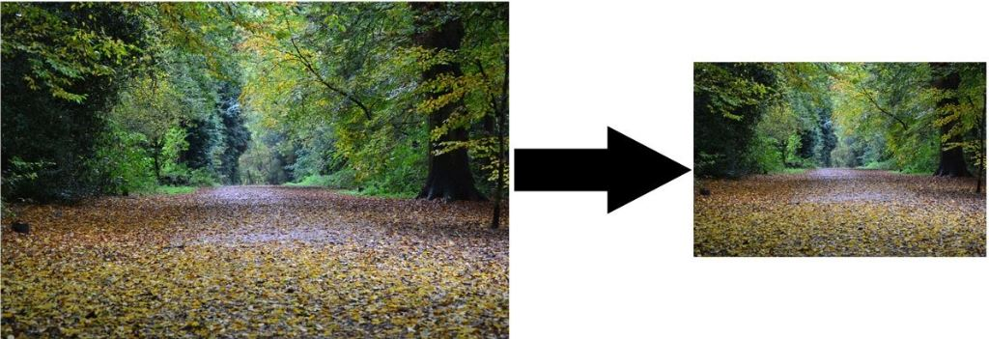
Geometric Operations
Scaling
Scaling means resizing an image which means an image is made bigger or smaller in x- or/and y-direction.
We can resize an image in terms of scaling factor or we can provide the size of the image we want.
Let’s understand by an example.
If we have an image of size (300 x 200) and we want to transform it into an image of shape (600 x 100).
The scaling in x- direction will be : 600/300 = 2. ( we denote it as S1 = 2)
Similarly S2 = 100/200 = 1/2.
Basically it means that the pixel in the input image at position (x, y) = (100,100) will be mapped to a new position (x’, y’) in the output image,
(x ‘, y’) = (100 * 2,100 *1/2) = (200, 50)
X’ = x * S1 (Eq. 3)
Y’ = y * S2 (Eq. 4)

Slide 49
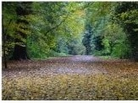
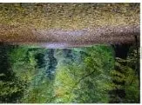
Geometric Operations
Rotation
As evident by its name, this technique rotates an image by a specified angle and by the given axis or point.
It performs a geometric transform which maps the position of a point in current image to the output image by rotating it by the user-defined angle through the specified axis.
The points that lie outside the boundary of an output image are ignored. Rotation is basically used for improvised visual appearance.
It’s a little different from other transforms.
X’ = x*cos(⊖) – y*sin(⊝) (Eq. 5)
Y’ = y*sin(⊝) + x*cos(⊝) (Eq. 6)
Here, (x, y) is the position of pixel in input image.
(x’, y’) is the position of pixel in output image.
⊝ is the angle by which an image to be rotated.
that the image is rotated 180 degrees through the origin.

Slide 50
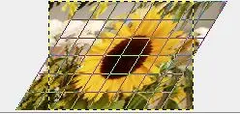
Geometric Operations
Shearing
Shearing an image means shifting the pixel values either horizontally or vertically. You must be thinking that it is sounding like Translation, but the difference is that shifting is not done by the same amount.
Basically, this shifts some part of an image to a direction and other parts to some other direction. For instance, horizontal shearing will shift the upper part to the right and lower part to the left. You can better understand this concept by visualization.

Slide 51
Spatial Operations in Image Processing,
A digital image is a two-dimensional array of size M x N where M is the number of rows and N is the number of columns in the array. A digital image is made up of a finite number of discrete picture elements called a pixel. The location of each pixel is given by coordinates (x, y) and the value of each pixel is given by intensity value f. Hence, the elements in a digital image can be represented by f(x, y).
Spatial Resolution
The term spatial resolution corresponds to the total number of pixels in the given image. If the number of pixels is more, then the resolution of the image is more.
Down-sampling
In the down-sampling technique, the number of pixels in the given image is reduced depending on the sampling frequency. Due to this, the resolution and size of the image decrease.
Up-sampling
The number of pixels in the down-sampled image can be increased by using up-sampling interpolation techniques. The up-sampling technique increases the resolution as well as the size of the image.

Slide 52
Spatial Operations in Image Processing,
Some commonly used up-sampling techniques are
Nearest neighbor interpolation
Bilinear interpolation
Cubic interpolation
In this article, we have implemented upsampling using Nearest neighbor interpolation by replicating rows and columns. As the sampling rate increases, artifacts will be seen in the reconstructed image.
However, by using bilinear interpolation or cubic interpolation, a better quality of the reconstructed image can be attained. Both Down sampling and Up Sampling can be illustrated in grayscale for better understandings because while reading images using OpenCV, some color values are manipulated, So we are going to convert the original input image into a black and white image.

Slide 53
Spatial Operations in Image Processing,
Some commonly used up-sampling techniques are
Nearest neighbor interpolation
Bilinear interpolation
Cubic interpolation
In this article, we have implemented upsampling using Nearest neighbor interpolation by replicating rows and columns. As the sampling rate increases, artifacts will be seen in the reconstructed image.
However, by using bilinear interpolation or cubic interpolation, a better quality of the reconstructed image can be attained. Both Down sampling and Up Sampling can be illustrated in grayscale for better understandings because while reading images using OpenCV, some color values are manipulated, So we are going to convert the original input image into a black and white image.

Slide 54
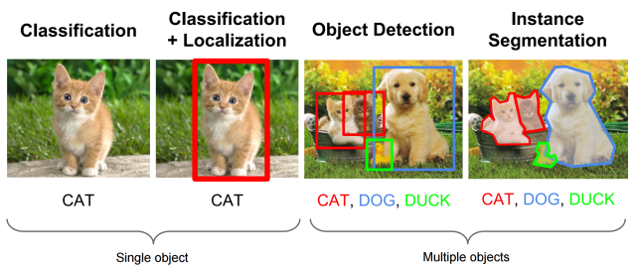
Localization and Object Detection
Classification/Recognition: Given an image with an object, find out what that object is. In other words, classify it in a class from a set of predefined categories.
Localization: Find where the object is and draw a bounding box around it
Object detection: Classify and detect all objects in the image. Assign a class to each object and draw a bounding box around it.
Semantic Segmentation: Classify every pixel in the image to a class according to its context, so that each pixel is assigned to an object
Instance Segmentation: Classify every pixel in the image to a class so that each pixel is assigned to a different instance of an object

Slide 55
Localization and Object Detection
Object Localization refers to the task of precisely identifying and localizing objects of interest within an image. It plays a crucial role in computer vision applications, enabling tasks like object detection, tracking, and segmentation. In the context of CNN-based localizers, object localization involves training a convolutional neural network (CNN) to predict the coordinates of bounding boxes that tightly enclose the objects within an image.
The localization process typically follows a two-step pipeline, with a backbone CNN extracting image features and a regression head predicting the bounding box coordinates. Object recognition is a general term to describe a collection of related computer vision tasks that involve identifying objects in digital photographs.
Image classification involves predicting the class of one object in an image. Object localization refers to identifying the location of one or more objects in an image and drawing abounding box around their extent. Object detection combines these two tasks and localizes and classifies one or more objects in an image.

Slide 56
Localization and Object Detection
Image Classification: Predict the type or class of an object in an image.
Input: An image with a single object, such as a photograph.
Output: A class label (e.g. one or more integers that are mapped to class labels).
Object Localization: Locate the presence of objects in an image and indicate their location with a bounding box.
Input: An image with one or more objects, such as a photograph.
Output: One or more bounding boxes (e.g. defined by a point, width, and height).
Object Detection: Locate the presence of objects with a bounding box and types or classes of the located objects in an image.
Input: An image with one or more objects, such as a photograph.
Output: One or more bounding boxes (e.g. defined by a point, width, and height), and a class label for each bounding box.

Slide 57

The Long-Term Dependencies problem in RNN
Object Detection
❏ Consider trying to predict the last word in the text “I grew up in France… I speak fluent French.” Recent information suggests that the next word is probably the name of a language,
❏ If we want to narrow down which language, we need the context of France,
❏ As that gap grows, RNNs become unable to learn to connect the information.
❏ LSTM (Long Short-Term Memory) and Gated Recurrent Unit solve this problem.

Slide 58
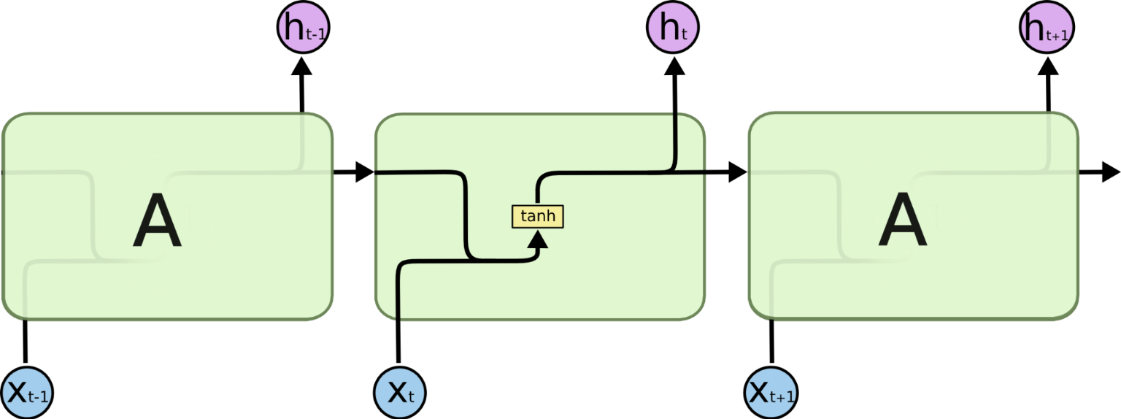
Long Short-Term Memory
Object Detection
❏ Long Short Term Memory networks – usually just called “LSTMs” – are a special kind of RNN, capable of learning long-term dependencies. They were introduced by Hochreiter & Schmidhuber (1997).
❏ All recurrent neural networks have the form of a chain of repeating modules of neural network. In standard RNNs, this repeating module will have a very simple structure, such as a single tanh layer.

Slide 59
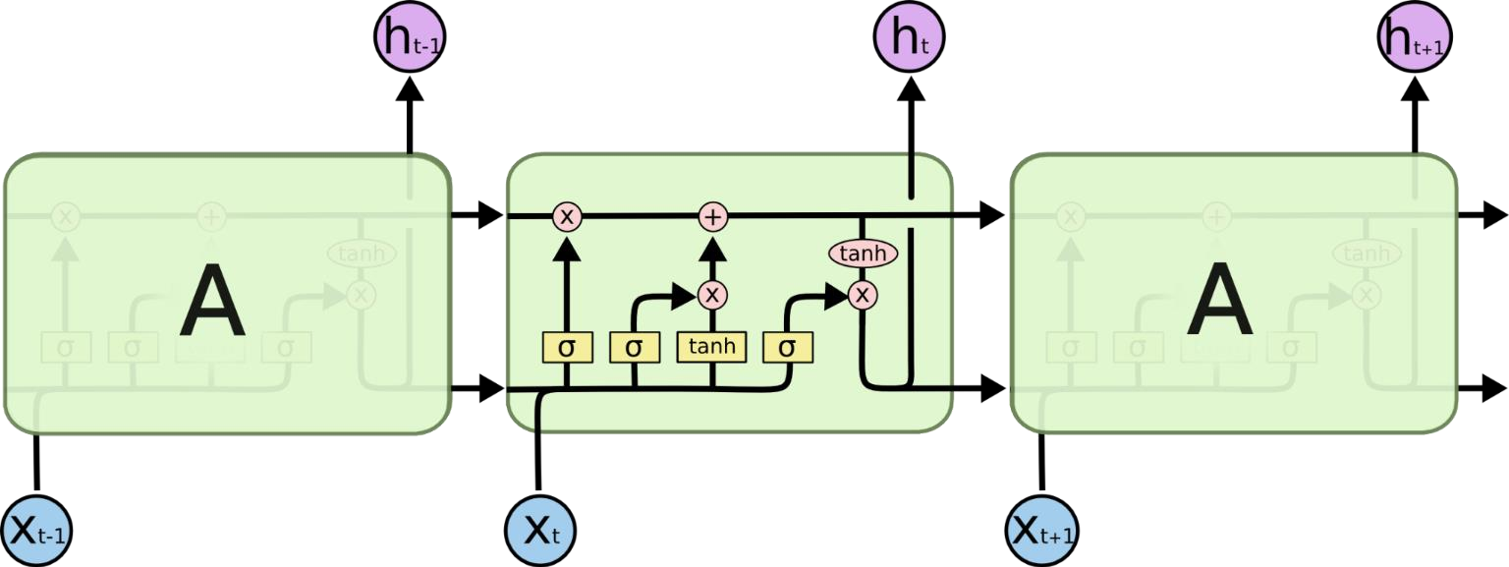
Object Detection
Long Short-Term Memory
❏ LSTMs also have this chain like structure, but the repeating module has a different structure. Instead of having a single neural network layer, there are four, interacting in a very special way.

Slide 60
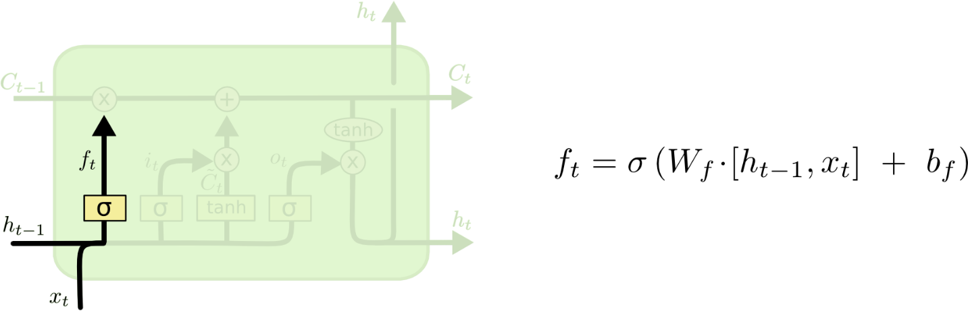
Object Detection
LSTM Walkthrough
❏ The first step in our LSTM is to decide what information we’re going to throw away from the cell state. This decision is made by a sigmoid layer called the “forget gate layer.
Picture courtesy: https://colah.github.io/

Slide 61
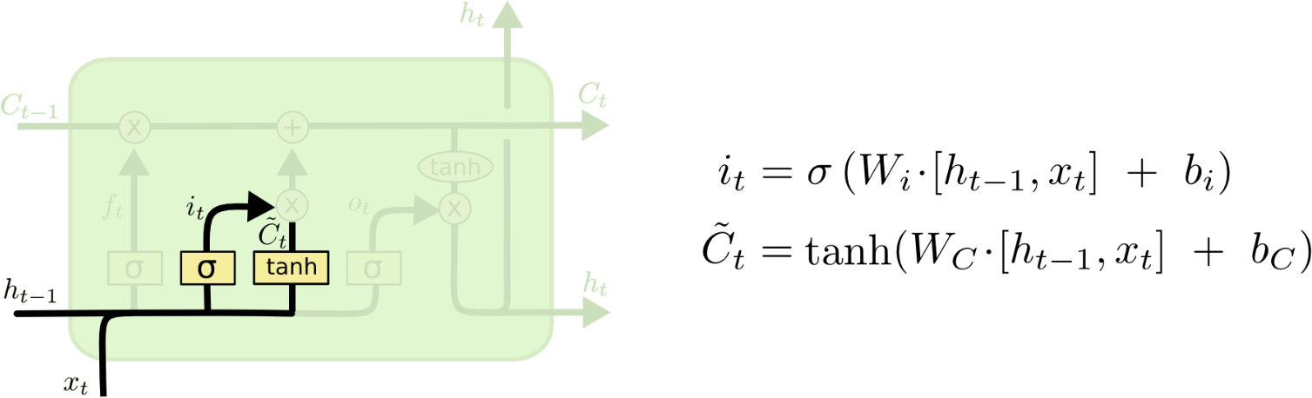
LSTM Walkthrough
Object Detection
❏ The next step is to decide what new information we’re going to store in the cell state. This has two parts. First, a sigmoid layer called the “input gate layer” decides which values we’ll update.
❏ Next, a tanh layer creates a vector of new candidate values, C_{t}, that could be added to the state. In the next step, we’ll combine these two to create an update to the state.
Picture courtesy: https://colah.github.io/

Slide 62
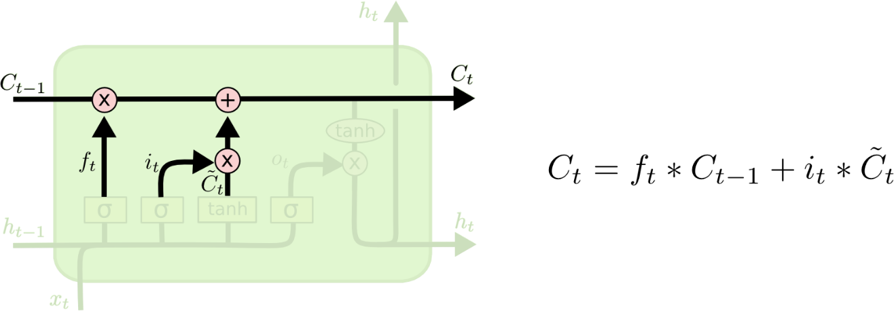
LSTM Walkthrough
Object Detection
❏ It’s now time to update the old cell state, C_{t−1}, into the new cell state C_{t}. The previous steps already decided what to do, we just need to actually do it.
❏ We multiply the old state by f_{t}, forgetting the things we decided to forget earlier. Then we add i_{t}∗C_{t}. This is the new candidate values, scaled by how much we decided to update each state value.
Picture courtesy: https://colah.github.io/

Slide 63
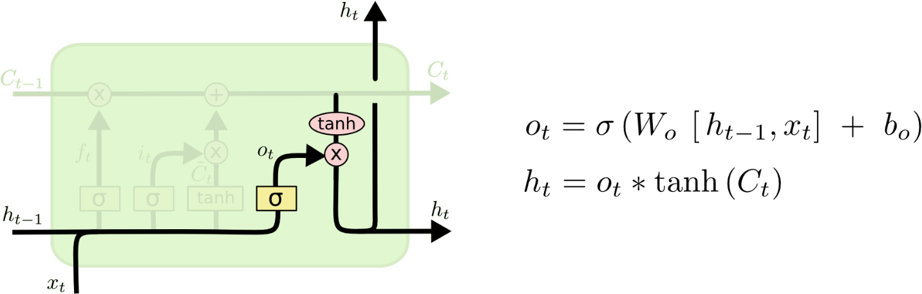
LSTM Walkthrough
Object Detection
❏ Finally, we need to decide what we’re going to output. This output will be based on our cell state, but will be a filtered version.
❏ First, we run a sigmoid layer which decides what parts of the cell state we’re going to output.
❏ Then, we put the cell state through tanh (to push the values to be between −1 and 1) and
multiply it by the output of the sigmoid gate, so that we only output the parts we decided to.
Picture courtesy: https://colah.github.io/

Slide 64

Object Detection
Gated Recurrent Unit
❏ GRU (Gated Recurrent Unit) aims to solve the Long Term Dependency, vanishing and exploding gradient problem which comes with a standard recurrent neural network. GRU can also be considered as a variation on the LSTM.

Slide 65
Object Detection
❏ It has update gate and reset gate. Basically, these are two vectors which decide what information should be passed to the output.
❏ The update gate helps the model to determine how much of the past information (from previous time steps) needs to be passed along to the future.
❏ Reset gate is used from the model to decide how much of the past
information to forget

Slide 66
To solve the vanishing gradient problem of a standard RNN, GRU uses, so called, update gate and reset gate. Basically, these are two vectors which decide what information should be passed to the output. The special thing about them is that they can be trained to keep information from long ago, without washing it through time or remove information which is irrelevant to the prediction.
GRUs are very similar to Long Short Term Memory(LSTM). Just like LSTM, GRU uses gates to control the flow of information. They are relatively new as compared to LSTM. This is the reason they offer some improvement over LSTM and have simpler architecture. Another Interesting thing about GRU is that, unlike LSTM, it does not have a separate cell state (Ct). It only has a hidden state(Ht). Due to the simpler architecture, GRUs are faster to train.

Slide 67



At each timestamp t, it takes an input Xt and the hidden state Ht-1 from the previous timestamp t-1. Later it outputs a new hidden state Ht which again passed to the next timestamp. If you remember from the LSTM gate equation it is very similar to that. The value of rt will range from 0 to 1 because of the sigmoid function. Here Ur and Wr are weight matrices for the reset gate.
Update Gate (Long Term memory)
Similarly, we have an Update gate for long-term memory and the equation of the gate is shown below. The only difference is of weight metrics i.e Uu and Wu.

Slide 68



How GRU Works
Now let’s see the functioning of these gates. To find the Hidden state Ht in GRU, it follows a two-step process. The first step is to generate what is known as the candidate hidden state. As shown below
Candidate Hidden State
If the value of rt is equal to 1 then it means tIt takes in the input and the hidden state from the previous timestamp t-1 which is multiplied by the reset gate output rt. Later passed this entire information to the tanh function, the resultant value is the candidate’s hidden state. The most important part of this equation is how we are using the value of the reset gate to control how much influence the previous hidden state can have on the candidate state.
The entire information from the previous hidden state Ht-1 is being considered. Likewise, if the value of rt is 0 then that means the information from the previous hidden state is completely ignored. Hidden state
Once we have the candidate state, it is used to generate the current hidden state Ht. It is where the Update gate comes into the picture. Now, this is a very interesting equation, instead of using a separate gate like in LSTM in GRU we use a single update gate to control both the historical information which is Ht-1 as well as the new information which comes from the candidate state.

Slide 69
#1. Update gate
We start with calculating the update gate z_t for time step t using the formula: When x_t is plugged into the network unit, it is multiplied by its own weight W(z). The same goes for h_(t-1) which holds the information for the previous t-1 units and is multiplied by its own weight U(z). Both results are added together and a sigmoid activation function is applied to squash the result between 0 and 1. The update gate helps the model to determine how much of the past information (from previous time steps) needs to be passed along to the future. That is really powerful because the model can decide to copy all the information from the past and eliminate the risk of vanishing gradient problem. We will see the usage of the update gate later on. For now remember the formula for z_t.
#2. Reset gate
Essentially, this gate is used from the model to decide how much of the past information to forget. To calculate it, we use:This formula is the same as the one for the update gate. The difference comes in the weights and the gate’s usage, which will see in a bit. The schema below shows where the reset gate is:

Slide 70
#3. Current memory content
Let’s see how exactly the gates will affect the final output. First, we start with the usage of the reset gate. We introduce a new memory content which will use the reset gate to store the relevant information from the past. It is calculated as follows:
Multiply the input x_t with a weight W and h_(t-1) with a weight U.
Calculate the Hadamard (element-wise) product between the reset gate r_t and Uh_(t-1). That will determine what to remove from the previous time steps. Let’s say we have a sentiment analysis problem for determining one’s opinion about a book from a review he wrote. The text starts with “This is a fantasy book which illustrates…” and after a couple paragraphs ends with “I didn’t quite enjoy the book because I think it captures too many details.” To determine the overall level of satisfaction from the book we only need the last part of the review. In that case as the neural network approaches to the end of the text it will learn to assign r_t vector close to 0, washing out the past and focusing only on the last sentences.
Sum up the results of step 1 and 2.
Apply the nonlinear activation function tanh.

Slide 71
#4. Final memory at current time step
As the last step, the network needs to calculate h_t — vector which holds information for the current unit and passes it down to the network. In order to do that the update gate is needed. It determines what to collect from the current memory content — h’_t and what from the previous steps — h_(t-1). That is done as follows:
Apply element-wise multiplication to the update gate z_t and h_(t-1).
Apply element-wise multiplication to (1-z_t) and h’_t.
Sum the results from step 1 and 2. Following through, you can see how z_t — green line is used to calculate 1-z_t which, combined with h’_t — bright green line, produces a result in the dark red line. z_t is also used with h_(t-1) — blue line in an element-wise multiplication. Finally, h_t — blue line is a result of the summation of the outputs corresponding to the bright and dark red lines.
Now, you can see how GRUs are able to store and filter the information using their update and reset gates. That eliminates the vanishing gradient problem since the model is not washing out the new input every single time but keeps the relevant information and passes it down to the next time steps of the network. If carefully trained, they can perform extremely well even in complex scenarios.

Slide 72
Segment Anything Model (SAM)
Segment Anything (SAM) is an image segmentation model developed by Meta Research, capable of doing zero-shot segmentation.
YOLOv8
Architecture:
YOLO, CNN
YOLOv8 is a state-of-the-art object detection and image segmentation model created by Ultralytics, the developers of YOLOv5.
YOLOv8 Instance Segmentation
The state-of-the-art YOLOv8 model comes with support for instance segmentation tasks.
GroundingDINO
Grounding DINO is a zero-shot object detection model made by combining a Transformer-based DINO detector and grounded pre-training.
YOLOv5A very fast and easy to use PyTorch model that achieves state of the art (or near state of the art) results.
YOLOv5 Oriented Bounding BoxesYOLOv5-OBB is a variant of YOLOv5 that supports oriented bounding boxes. This model is designed to yield predictions that better fit objects that are positioned at an angle.
YOLOv5 ClassificationYOLOv5 Classification is a version of the YOLOv5 model used in single-label and multi-label image classification.
Detectron2Detectron2 is model zoo of it's own for computer vision models written in PyTorch.
Mask RCNNMask RCNN is a convolutional neural network for instance segmentation.

Slide 73
YOLOv4 DarknetYOLOv4 has emerged as the best real time object detection model. YOLOv4 carries forward many of the research contributions of the YOLO family of models along with new modeling and data augmentation techniques. This implementation is in Darknet.
OpenAI CLIPCLIP (Contrastive Language-Image Pre-Training) is an impressive multimodal zero-shot image classifier that achieves impressive results in a wide range of domains with no fine-tuning. It applies the recent advancements in large-scale transformers like GPT-3 to the vision arena.
Faster R-CNNOne of the most accurate object detection algorithms but requires a lot of power at inference time. A good choice if you can do processing asynchronously on a server.
EfficientNetEfficientNet is from a family of image classification models from GoogleAI that train comparatively quickly on small amounts of data, making the most of limited datasets.
FastSAMFastSAMFastSAM is an image segmentation model trained using 2% of the data in the Segment Anything Model SA-1B dataset.
MobileNet SSD v2This architecture provides good realtime results on limited compute. It's designed to run in realtime (30 frames per second) even on mobile devices.
ResNet 34A fast, simple convolutional neural network that gets the job done for many tasks, including classification.
MobileNet V2 ClassificationMobileNet is a GoogleAI model well-suited for on-device, real-time classification (distinct from MobileNetSSD, Single Shot Detector). This implementation leverages transfer learning from ImageNet to your dataset.
L2CS-NetL2CS-Net is a gaze estimation model that enables you to calculate where someone is looking and in what direction someone is looking.

Slide 74
Vision Languages : There are several programming languages suitable for implementing computer vision systems, some of them easy to learn and some of them hard for a new developer.
MATLAB
MATLAB is a program for analyzing data, creating algorithms, and creating models that engineers and scientists use every day
Pros:
MATLAB is widely used in academia, especially for prototyping and testing new ideas.
MATLAB is well known as a programming language with very good algorithm implementations and extensive toolbox options, with its integrated graphical interface, MATLAB lets you edit code, display output, plot figures, manipulate data, and more, all of them in MATLAB IDE.
MATLAB known for its built-in vector variables that make vector-like programming to be very convenient, MATLAB provides an easy debugging experience with a good user experience.
Cons:
MATLAB is not designed for a production environment, another major con is that MATLAB costs around 2500$ for a standard license, plus a yearly fee.
A major drawback of MATLAB is that it is extremely slow in executing code, and the learning curve is quite long since its syntax is different from general-purpose programming languages, such as C, C++, and Python.

Slide 75
Vision Languages :C++
C++, also known as the “C with Classes” programming language, is a general-purpose programming language developed by Bjarne Stroustrup
👍 Pros:
C++ enables its users to run the same program on different operating systems easily.
One of C++’s biggest benefits is its object-oriented model that includes concepts like classes, inheritance, polymorphism, data abstraction, and encapsulation, expanding reusability and reliability.
Embedded systems and compilers leverage C++ for low-level machine manipulation.
In C++, the programmer has access to control over memory management, but this comes at a cost as there is a greater responsibility to manage memory as opposed to it being handled by the Garbage Collector.
C++ can handle small datasets as well as large ones, and it can handle intensive processes.
Cons:
On the other hand, C++ is quite hard for beginners, If you have no experience programming in C++, It’s probably more productive to try Python instead
Pointers in C/C++ are a complex notion, utilizing an excessive amount of memory. The use of generalized pointers, such as ‘wild pointers’, can cause the app to crash or function erratically.

Slide 76
Vision Languages :Python
The Python programming language is an interpreted, general-purpose language. Python uses a significant indentation in its design emphasizes code readability. The language implements an object-oriented approach to enable programmers to write logical, clear code for both small and large projects
Pros:
Python is aimed for both new and experienced coders to be able to convert ideas into code easily.
As one of the most mature, prevalent, and well-supported languages in the area of machine learning, Python is a natural choice for running computer vision code.
Computer vision can be implemented through the Python programming language, allowing developers to carry out visualization-based tasks at high speeds.
Python is commonly used in machine learning. Data scientists invest their time contributing because it’s fairly simple to write code in Python, and it’s free and open-source.
Cons:
Python is an interpreted language, so it often sacrifices the speed of a compiled language and it leads to slow code execution

Slide 77
Active Contours – A Method for Image Segmentation in Computer Vision
Active contour is a segmentation method that uses energy forces and constraints to separate the pixels of interest from a picture for further processing and analysis.
Active contour is defined as an active model for the segmentation process. Contours are the boundaries that define the region of interest in an image. A contour is a collection of points that have been interpolated. The interpolation procedure might be linear, splines, or polynomial, depending on how the curve in the image is described.
Contours is needed?
The primary use of active contours in image processing is to define smooth shapes in images and to construct closed contours for regions. It is mainly used to identify uneven shapes in images.
Active contours are used in a variety of medical image segmentation applications. Various forms of active contour models are employed in a variety of medical applications, particularly for the separation of desired regions from a variety of medical images. A slice of a brain CT scan, for example, is examined for segmentation using active contour models.

Slide 78
Active Contour work?
Active contours are the technique of obtaining deformable models or structures in an image with constraints and forces for segmentation. Contour models define the object borders or other picture features to generate a parametric curve or contour.
The curvature of the models is determined using several contour techniques that employ external and internal forces. The energy function is always related to the image’s curve. External energy is described as the sum of forces caused by the picture that is specifically used to control the location of the contour onto the image, and internal energy, which is used to govern deformable changes.
The contour segmentation constraints for a certain image are determined by the needs. The desired shape is obtained by defining the energy function. A collection of points that locate a contour is used to describe contour deformation. This shape corresponds to the desired image contour, which was defined by minimizing the energy function. Active Contour Segmentation Models
1. Snake Model
The snake model is a technique that has the ability to solve a broad range of segmentation problems. The model’s primary function is to identify and outline the target object for segmentation. It requires some prior knowledge of the target object’s shape, especially for complicated things. Active snake models, often known as snakes, are generally configured by the use of spline focused on minimizing energy, followed by various forces governing the image.

Slide 79

Equation
A simple snake model can be denoted by a set of n points, v_{i} for i=0,….n-1, the internal elastic energy term E_{Internal} and the external edge-based energy term E_{external}. The internal energy term’s aim is to regulate the snake’s deformations, while the exterior energy term’s function is to control the contour’s fitting onto the image. The external energy is typically a combination of forces caused by the picture E_{image} and constraint forces imposed by the user E_{con}.
Advantage
The applications of the active snake model are expanding rapidly, particularly in the many imaging domains. In the field of medical imaging, the snake model is used to segment one portion of an image that has unique characteristics when compared to other regions of the picture. Traditional snake model applications in medical imaging include optic disc and cup segmentation to identify glaucoma, cell image segmentation, vascular region segmentation, and several other regions segmentation for diagnosis and study of disorders or anomalies.
Disadvantage
The conventional active snake model approach has various inefficiencies, such as noise sensitivity and erroneous contour detection in high-complexity objects, which are addressed in advanced contour methods.

Slide 80
Gradient Vector Flow Model
The gradient vector flow model is a more developed and well-defined version of the snake or active contour models. The traditional snake model has two limitations: inadequate contour convergence for concave borders and when the snake curve flow is commenced at a great distance from the minimum. As an extension, the gradient vector flow model uses the gradient vector flow field as an energy constraint to determine the contour flow.
Equation
In 2D, the GVF vector field F_{GVF} minimizes the energy functional

Slide 81
Balloon Model
A snake model isn’t drawn to far-off edges. If no significant image forces apply to the snake model, its inner side will shrink. A snake that is larger than the minima contour will eventually shrink into it, whereas a snake that is smaller than the minima contour will not discover the minima and will instead continue to shrink. To address the constraints of the snake model, the balloon model was developed, in which an inflation factor is incorporated into the forces acting on the snake. The inflation force can overwhelm forces from weak edges, exacerbating the problem with first guess localization.
Equation
Inflation term into the forces acting on the snake is introduced in the balloon model.
Advantage
The balloon concept is used to segment various medical pictures. The application’s primary purpose is to propose a novel technique for segmenting 2-D images and reconstructing 3-D meshes that ensures a watertight mesh.
Disadvantage
The balloon model’s biggest problem is its slow processing, which makes it difficult to manage sharp edges and requires careful object placement. The balloon model is commonly used in analyzing picture contour extraction.

Slide 82


Geometric or geodesic active contour models
Geometric active contour (GAC) is a form of contour model that adjusts the smooth curve established in the Euclidean plan by moving the curve’s points perpendicular. The points move at a rate proportionate to the curvature of the image’s region. The geometric flow of the curve and the recognition of items in the image are used to characterize contours. Geometric flow encompasses both internal and external geometric measures in the region of interest. In the process of detecting items in an image, a geometric replacement for snakes is utilized. These contour models rely heavily on the level set functions that specify the image’s unique regions for segmentation.
where g(I) is a halting function, c is a Lagrange multiplier, K is the curvature, and vector N is the unit inward normal. This particular form of curve evolution equation is only dependent on the velocity in the normal direction. It, therefore, can be rewritten equivalently in an Eulerian form by inserting the level set function φ into it as follows

Slide 83
Advantage
Geometric active contours are mostly used in medical image computing, particularly image-based segmentation. In this case, any imaging modality’s picture is examined for segmentation in order to research, process, and analyze the regions of interest. These regions include any aberration that forms in the interior regions or organs of the human body, such as blood clots, traumas, lesions, cell abnormalities, metabolic interruptions, biomolecule disruptions, and so on.
Disadvantage
Mostly it has no such inefficiencies but they are difficult to implement as they are complex in nature.

Slide 84
Segmentation as clustering
Cluster together (pixels, tokens, etc.) that belong together…
Agglomerative clustering
attach closest to cluster it is closest to
repeat
Divisive clustering
split cluster along best boundary
repeat
Dendrograms
yield a picture of output as clustering process continues

Slide 85


Greedy Clustering Algorithms

Slide 86


Data set
Dendrogram formed by agglomerative clustering using single-link clustering.

Slide 87
Segment foreground from background
K-means clustering
Mean-shift segmentation
Normalized cuts

Slide 88
K-Means
Choose a fixed number of • clusters
Algorithm
fix cluster centers; allocate points to closest cluster
fix allocation; compute best cluster centers
x could be any set of features for which we can compute a distance (careful about scaling)
Choose cluster centers and point-cluster allocations to minimize error
can’t do this by search, because there are too many possible allocations.
⎧
2 ⎫
⎬
⎭
∑ ∑
x _{j} − μ_{i}
⎨
i∈clusters ⎩ j∈elements of i'th cluster

Slide 89

K-Means

Slide 90
Matlab k-means clustering demo

Slide 91



Image
Clusters on intensity (K=5)
Clusters on color (K=5)
K-means clustering using intensity alone and color alone

Slide 92

Image
Clusters on color
K-means using color alone, 11 segments

Slide 93




K-means using color alone,
11 segments.
Color alone often will not
yeild salient segments!

Slide 94
Ways to include spatial relationships
Define a Markov Random Field (MRF), where the state to be estimated includes the segment index. Solve by graph cuts or BP.
Augment data to be clustered with spatial
coordinates.
⎛Y ⎞
⎜ ⎟
⎜ u ⎟
color coordinates
_{z =} ⎜ _{v} ⎟
⎜ _{x} ⎟
⎜ ⎟
spatial coordinates
⎜ _{y} ⎟
⎝ ⎠

Slide 95





K-means using colour and position, 20 segments
Still misses goal of perceptually pleasing segmentation!
Hard to pick K…

Slide 96
Segmentation methods
Segment foreground from background
K-means clustering
Mean-shift segmentation
Normalized cuts

Slide 97

Mean Shift Segmentation

Slide 98


Mean Shift Algorithm
Mean Shift Algorithm
Choose a search window size.
Choose the initial location of the search window.
Compute the mean location (centroid of the data) in the search window.
Center the search window at the mean location computed in Step 3.
Repeat Steps 3 and 4 until convergence.
The mean shift algorithm seeks the “mode” or point of highest density of a data distribution:

Slide 99

Mean Shift Segmentation
Mean Shift Segmentation Algorithm
Convert the image into tokens (via color, gradients, texture measures etc).
Choose initial search window locations uniformly in the data.
Compute the mean shift window location for each initial position.
Merge windows that end up on the same “peak” or mode.
The data these merged windows traversed are clustered together.
*Image From: Dorin Comaniciu and Peter Meer, Distribution Free Decomposition of Multivariate Data, Pattern Analysis & Applications (1999)2:22–30

Slide 100

Comaniciu and Meer, IEEE PAMI vol. 24, no. 5, 2002

Slide 101



Apply mean shift jointly in the image (left col.) and range (right col.) domains
Window in image domain
1
Intensities of pixels within
image domain window
0 1
2
Center of mass of pixels within both image and range domain windows
3
0 1
Window in range domain
4
Center of mass of pixels within both image and range domain windows
5
6
0
1
7
0
1

Slide 102




Mean Shift color&spatial Segmentation Results:

Slide 103


Mean Shift color&spatial Segmentation Results:

Slide 104
Segmentation methods
Segment foreground from background
K-means clustering
Mean-shift segmentation
Normalized cuts

Slide 105






Graph-Theoretic Image Segmentation
Build a weighted graph G=(V,E) from image
V: image pixels
E: connections between pairs of nearby pixels

Slide 106
Graphs Representations
⎡0 1 0 0 1⎤
⎢ 0 0 0 ⎥
⎢0 0 0 0 1⎥
⎢0 0 0 0 1⎥
⎢⎣1 0 1 1 0⎦⎥
a
⎢₁
₀⎥
b
c
⎢
⎥
e
d
Adjacency Matrix

Slide 107

Weighted Graphs and Their Representations
a |  | b |  | ⎡0 ⎢₁ | 1 0 | 3 4 | ∞ ∞ | ∞⎤ ₂⎥ ⎥
 | c 6 |  | e | ⎢3 ⎢∞ ⎢⎣∞ | 4 ∞ 2 | 0 6 7 | 6 0 1 | 7⎥ ₁⎥ ⎥ ₀⎥⎦
⎢
⎢
d
Weight Matrix

Slide 108

Boundaries of image regions defined by a number of attributes
Brightness/color
Texture
Motion
Stereoscopic depth
Familiar configuration

Slide 109
Measuring Affinity
Intensity
2 (
)
aff (x, y)= exp⎧−^{⎛ 1}
⎞
I(x)− I(y)
2 ⎫
⎨ ⎝
2σ ⎠
⎬
⎩
i
⎭
Distance
⎫
aff (x, y)= exp⎧−^{⎛ 1}
⎞
( )⎬
⎨ ⎝
x − y
2
2σ ⎠
⎩
2
⎭
d
Color
2 (
)
aff (x, y)= exp⎧−^{⎛ 1}
⎞
c(x)− c(y)
2 ⎫
⎨ ⎝
2σ ⎠
⎬
⎩
t
⎭

Slide 110
Eigenvectors and affinity clusters
Simplest idea: we want a vector a giving the association between each element and a cluster
We want elements within this cluster to, on the whole, have strong affinity with one another
We could maximize
a^{T} Aa
But need the constraint
a^{T} a = 1
This is an eigenvalue problem (p. 321 of Forsyth&Ponce)
- choose the eigenvector of A with largest eigenvalue

Slide 111



Example eigenvector
points
eigenvector
matrix

Slide 112
Example eigenvector
points
eigenvector
matrix

Slide 113

Scale affects affinity
σ=.2
σ=.1
σ=.2
σ=1

Slide 114

Some Terminology for Graph Partitioning
How do we bipartition a graph:
cut(A, B) = ∑W(u, v),
u∈A,v∈B
assoc(A, A') = ∑W(u, v)
u∈A,v∈A'
with A ∩ B = ∅
A and A' not necessarily disjoint

Slide 115
Minimum Cut
A cut of a graph G is the set of edges S such that removal of
S from G disconnects G.
Minimum cut is the cut of minimum weight, where weight of cut <A,B> is given as
w( A, B )= ∑_{x∈A, y∈B} w(x, y)

Slide 116



Minimum Cut and Clustering
*

Slide 117
Drawbacks of Minimum Cut
Weight of cut is directly proportional to the number of edges in the cut.
Cuts with lesser weight than the ideal cut
Ideal Cut
*

Slide 118
Normalized cuts
First eigenvector of affinity matrix captures within cluster similarity, but not across cluster difference
Min-cut can find degenerate clusters
Instead, we’d like to maximize the within cluster similarity compared to the across cluster difference
Write graph as V, one cluster as A and the other as B
Minimize
cut(A,B) cut(A,B)
+
assoc(A,V) assoc(B,V)
where cut(A,B) is sum of weights with one end in A and one end in B; assoc(A,V) is sum of all edges with one end in A.
I.e. construct A, B such that their within cluster similarity is high compared to their association with the rest of the graph

Slide 119
Solving the Normalized Cut problem
Exact discrete solution to Ncut is NP-complete even on regular grid,
– [Papadimitriou’97]
Drawing on spectral graph theory, good approximation can be obtained by solving a generalized eigenvalue problem.

Slide 120
^{D}ii ⁼ ∑^{A}ij
j
Normalized Cut As Generalized Eigenvalue problem
assoc(A,V) assoc(B,V)
cut(A,B) cut(A,B)
₌ (1+ x)^{T} (D−W)(1+ x) ₊ (1− x)^{T} (D−W)(1− x)
k1^{T} D1 (1−k)1^{T} D1
=...
after simplification, Shi and Malik derive
Ncut(A,B)=
+
∑
D(i,i)
; k =
x >0
i
∑D(i,i)
i
y^{T} (D −W)y
Ncut(A, B)= , withy ∈{1,−
T
b}, y D1= 0.
y^{T} Dy
i

Slide 121
max_{y} (y (D − W )y) subject to (y Dy = 1)
T T
Normalized cuts
Instead, solve the generalized eigenvalue problem
which gives
(D − W )y = λDy
They show that the 2nd smallest eigenvector solution y is a good real- valued appox to the original normalized cuts problem. Then you look for a quantization threshold that maximizes the criterion --- i.e all components of y above that threshold go to one, all below go to -b

Slide 122







Brightness Image Segmentation

